Slide 1
Life
Find the table matching your card rank
Introduce yourself
Start working with your tablemates on classifying listed items and defining “life”
19 January 2022
University of Virginia
https://computingbiology.github.io
David Evans

Slide 2
Plan for Today
What is Life?
About the Course
Why I’m teaching this course
Course expectations
Defining Life
Why is Life Digital?

Slide 3
Is it alive?
Jelly Donut | Ant Colony
Silicon-based alien | Infertile salamander
Human who decides not to reproduce | E. coli bacterium
Self-replicating computer program | mRNA Vaccine
Frozen human embryo | Internet meme
SARS-Cov-2 virus | 3D Printer that can print itself

Slide 4
Challenges in Defining “Life”

Slide 5
Definitions
How are definitions in computer science different from definitions in biology?

Slide 6
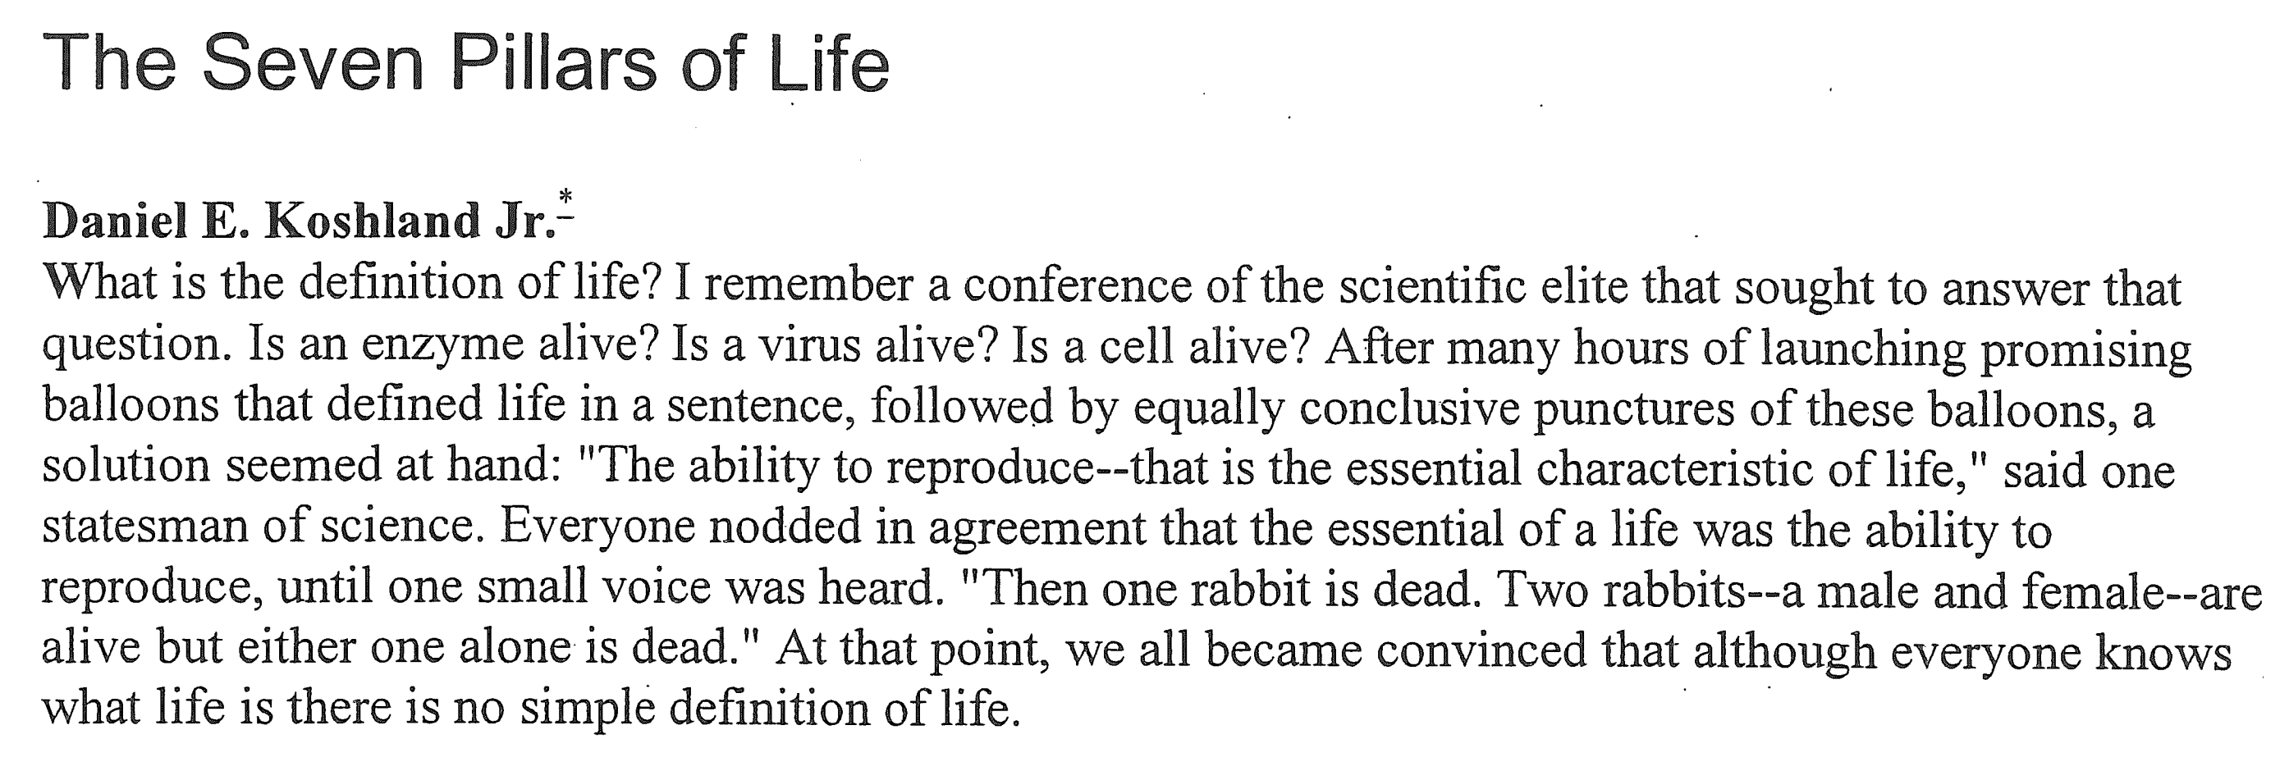

Slide 7

Koshland’s Definition
“If I were forced to rush in where angels fear to tread, I would offer “a living organism is an organized unit, which can carry out metabolic reactions, defend itself against injury, respond to stimuli, and has the capacity to be at least a partner in reproduction.”

Slide 8
Koshland’s Seven Pillars (Necessary for Life)
Program: an organized plan
Improvisation: some way to change its program
Compartmentalization: “confined to limited volume, surrounded by a surface”
Energy: metabolizing system
Regeneration: way to replace lost resources
Adaptability: respond quickly to changing environment
Seclusion: independent chemical pathways (specificity of enzymes)

Slide 9
What this Course is About
Computational Biology / Biological Computing

Slide 10
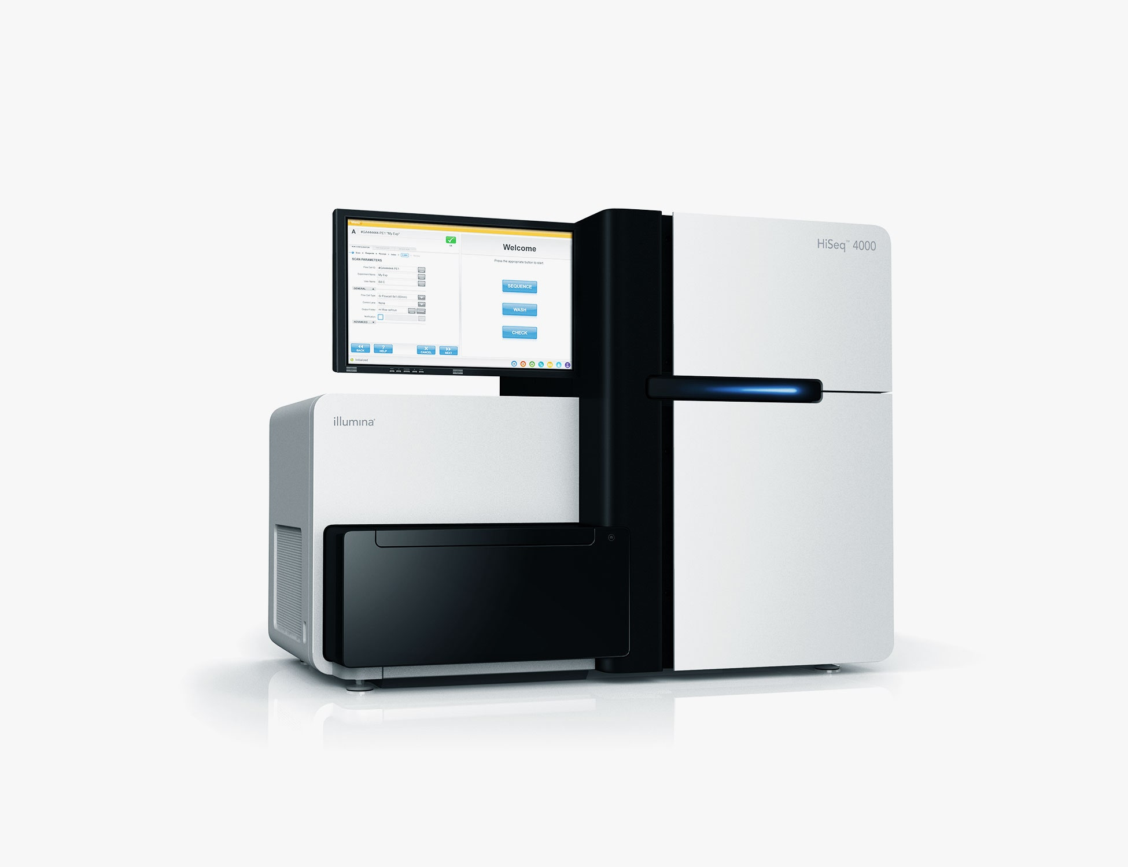
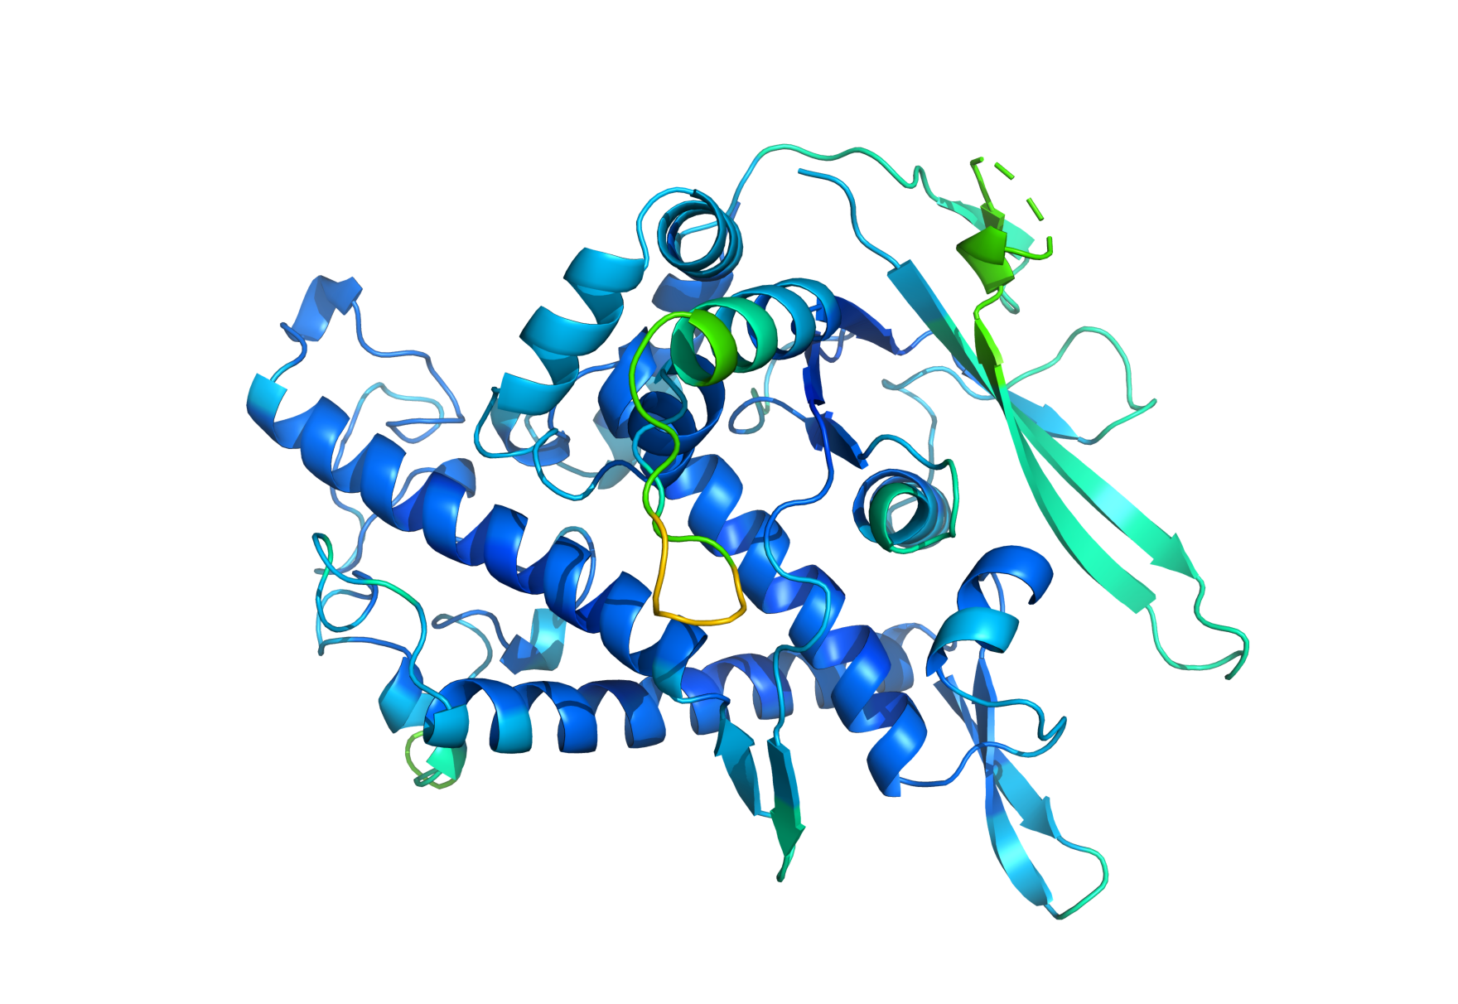
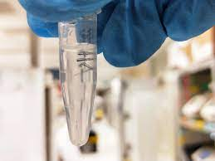
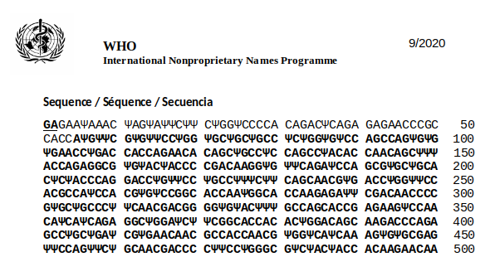
Computational Biology
Goal of computational biology/bioinformatics is to map messy biological problems into well defined computing problems, and solving those problems to provide useful biological results.
Algorithms
Biology Lab Methods
Data
Computer Science Methods
Biologically-Useful
Result
Biological Stuff,
Observations

Slide 11
Biological Computing
Using biological mechanisms to perform computation

Slide 12
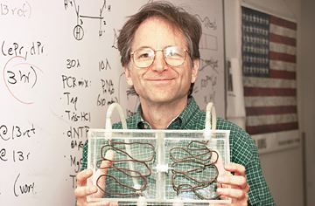
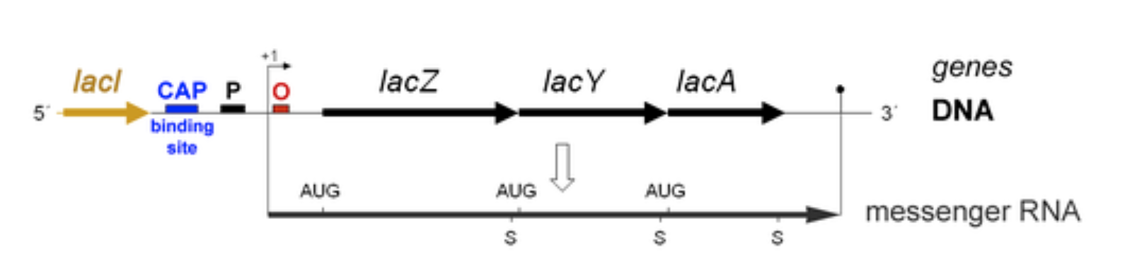
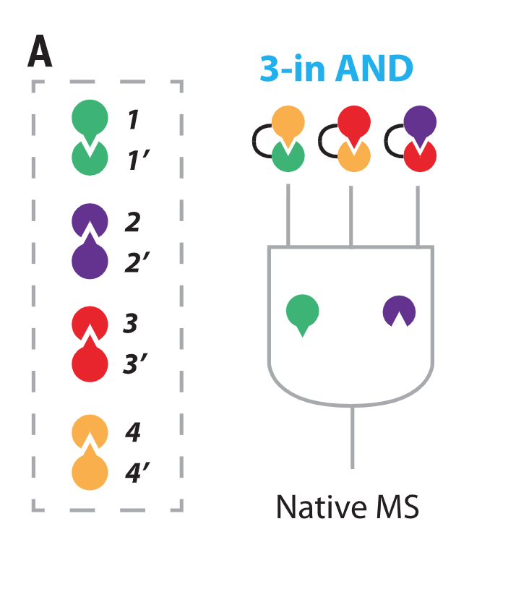
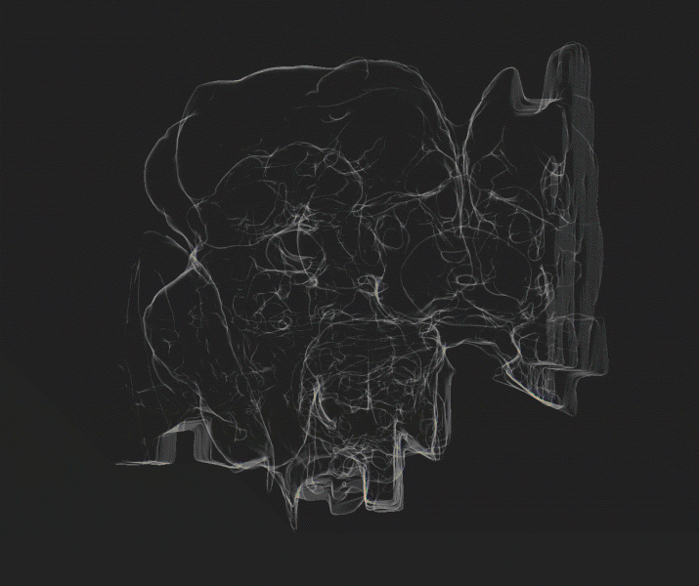
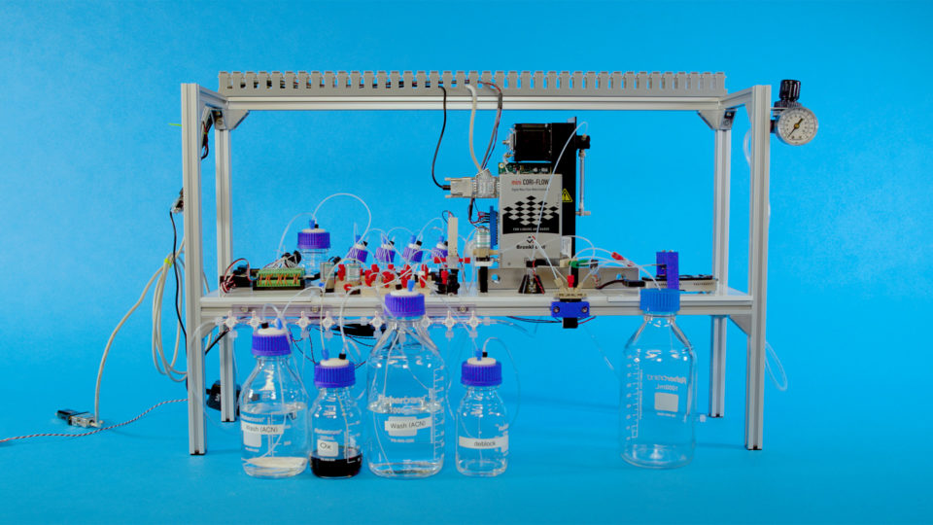
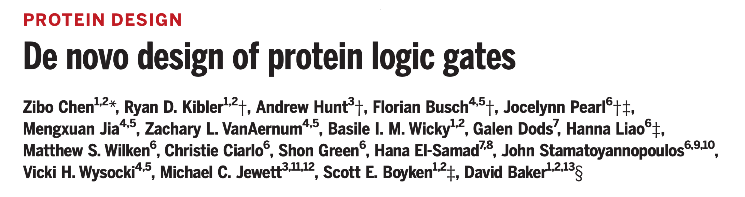
Biological Computing
Naturally In Nature
Artificially In Nature
Artificially for Computing
Lac feedback control
Len Adelman’s DNA Computer
Neural Networks
(Drosophila Connectome)
DNA Storage (Microsoft/UW)

Slide 13
Computational Biology / Biological Computing

Slide 14
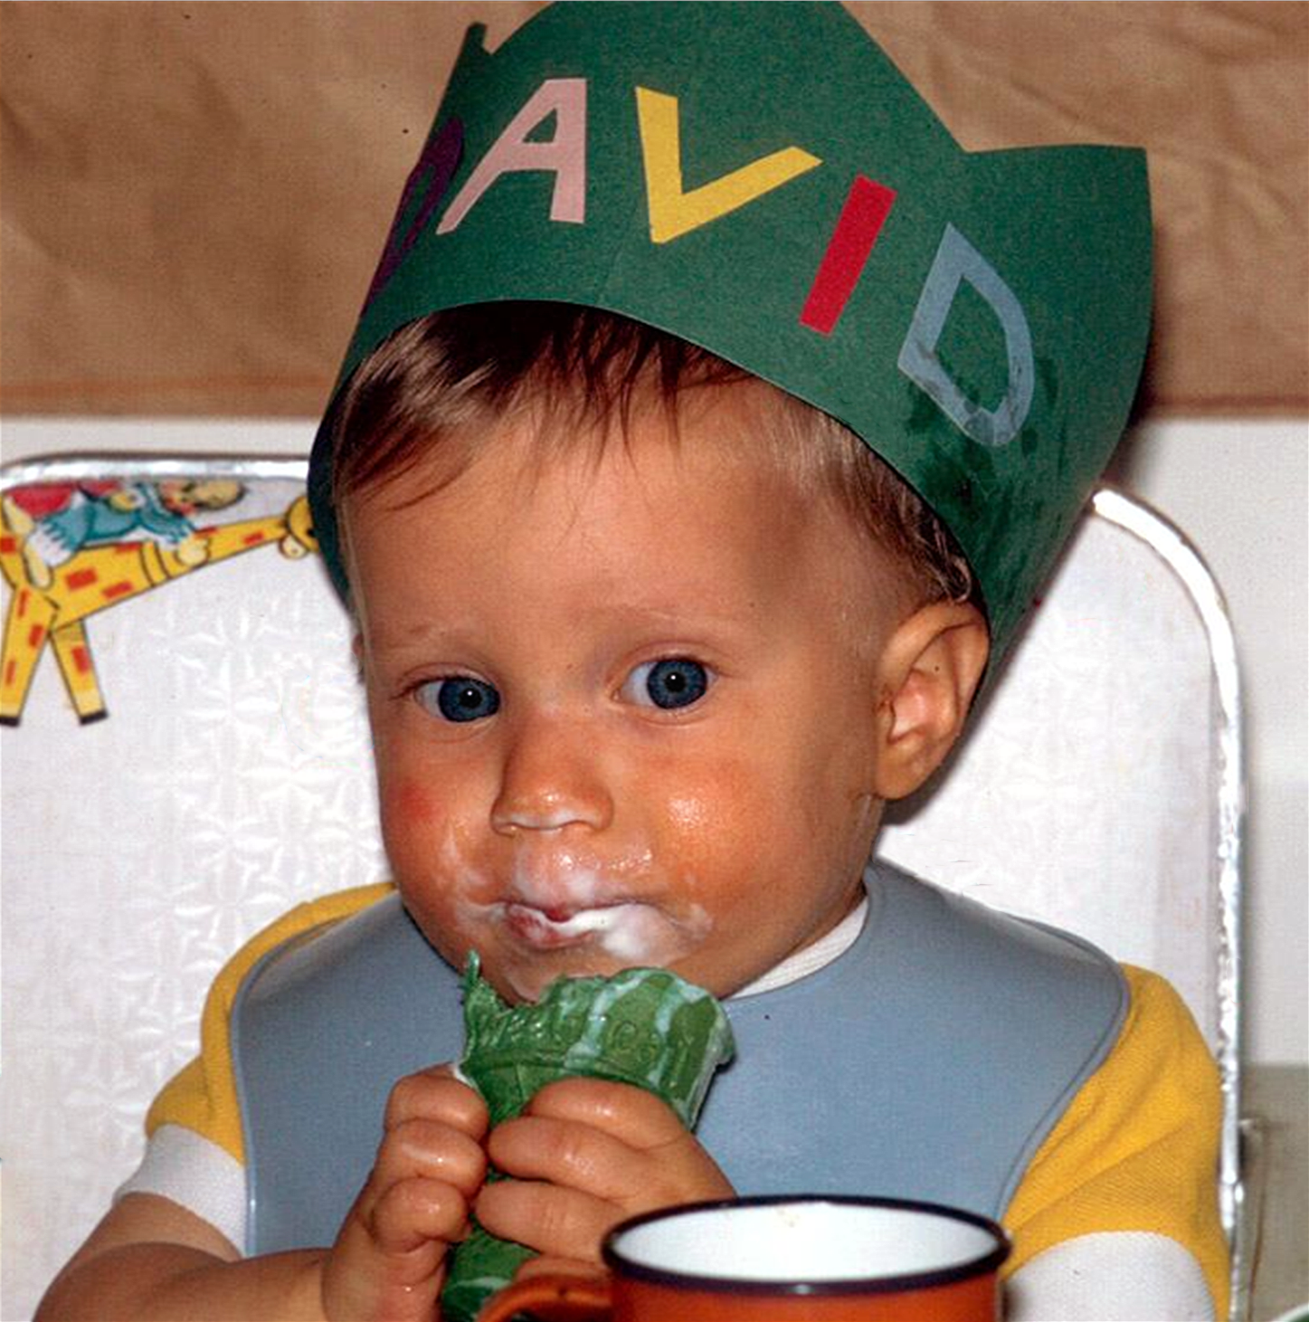

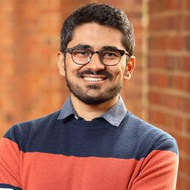
Course Team
David Evans
Hjun Jae Cho
Anshuman Suri

Slide 15
Why I’m Teaching this Course

Slide 16
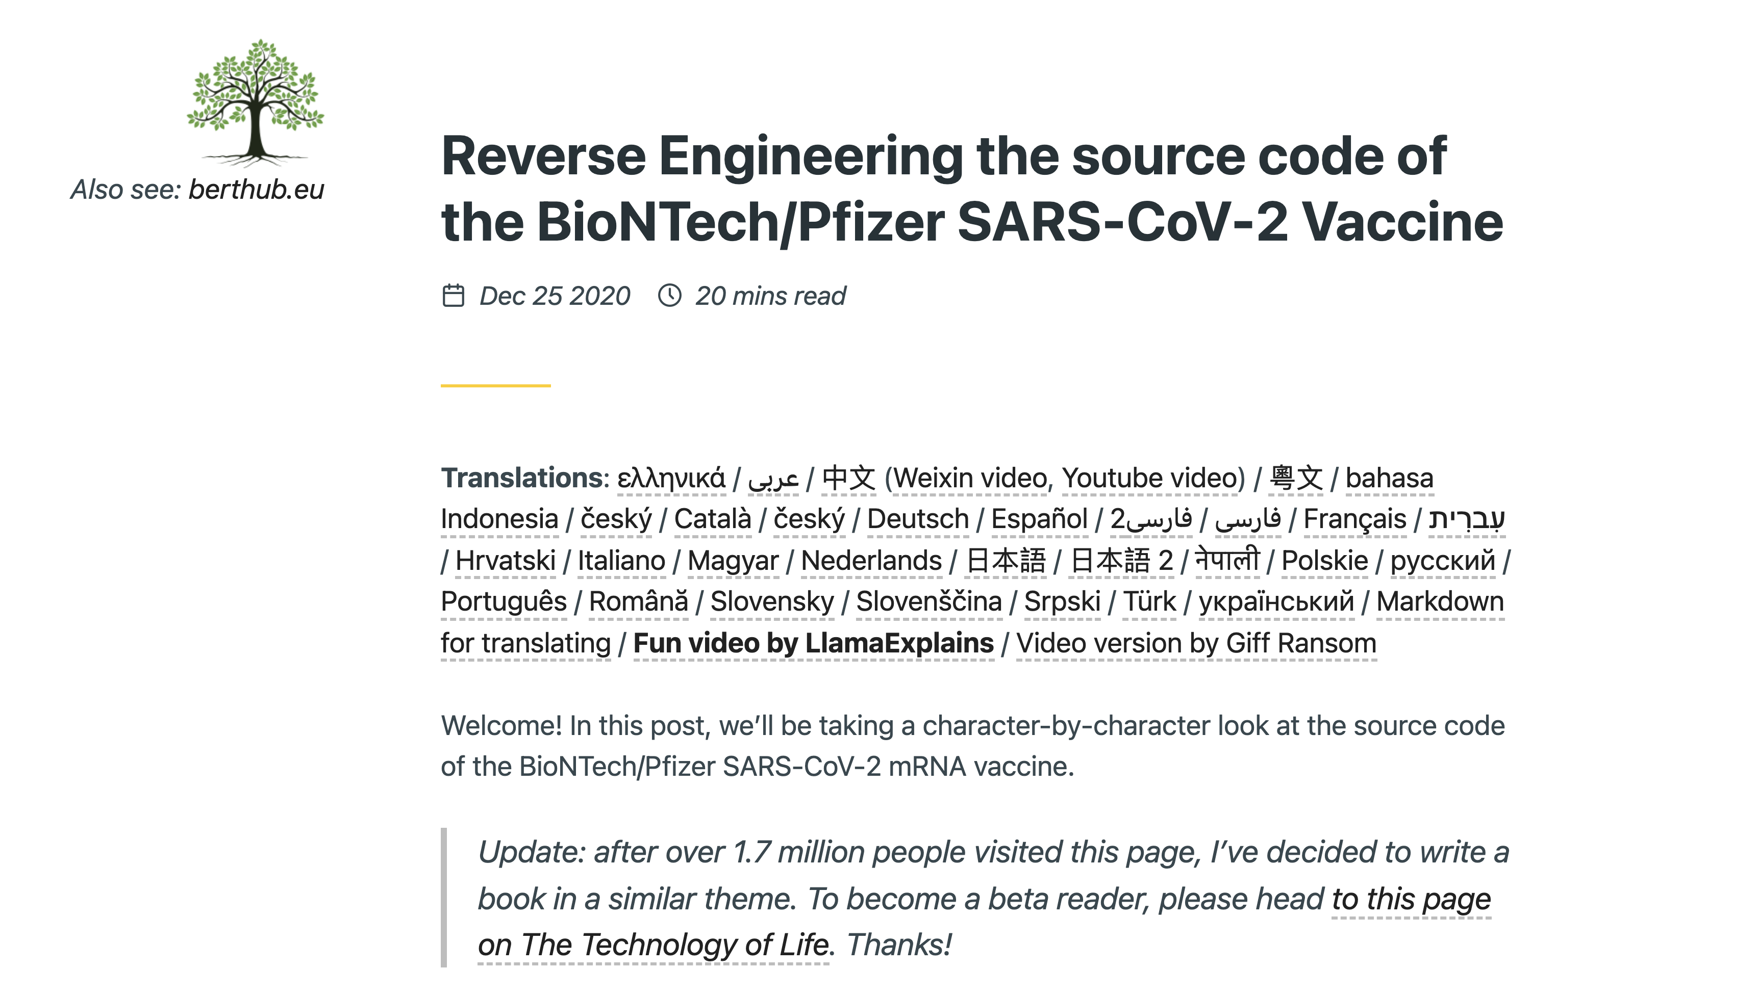

Slide 17
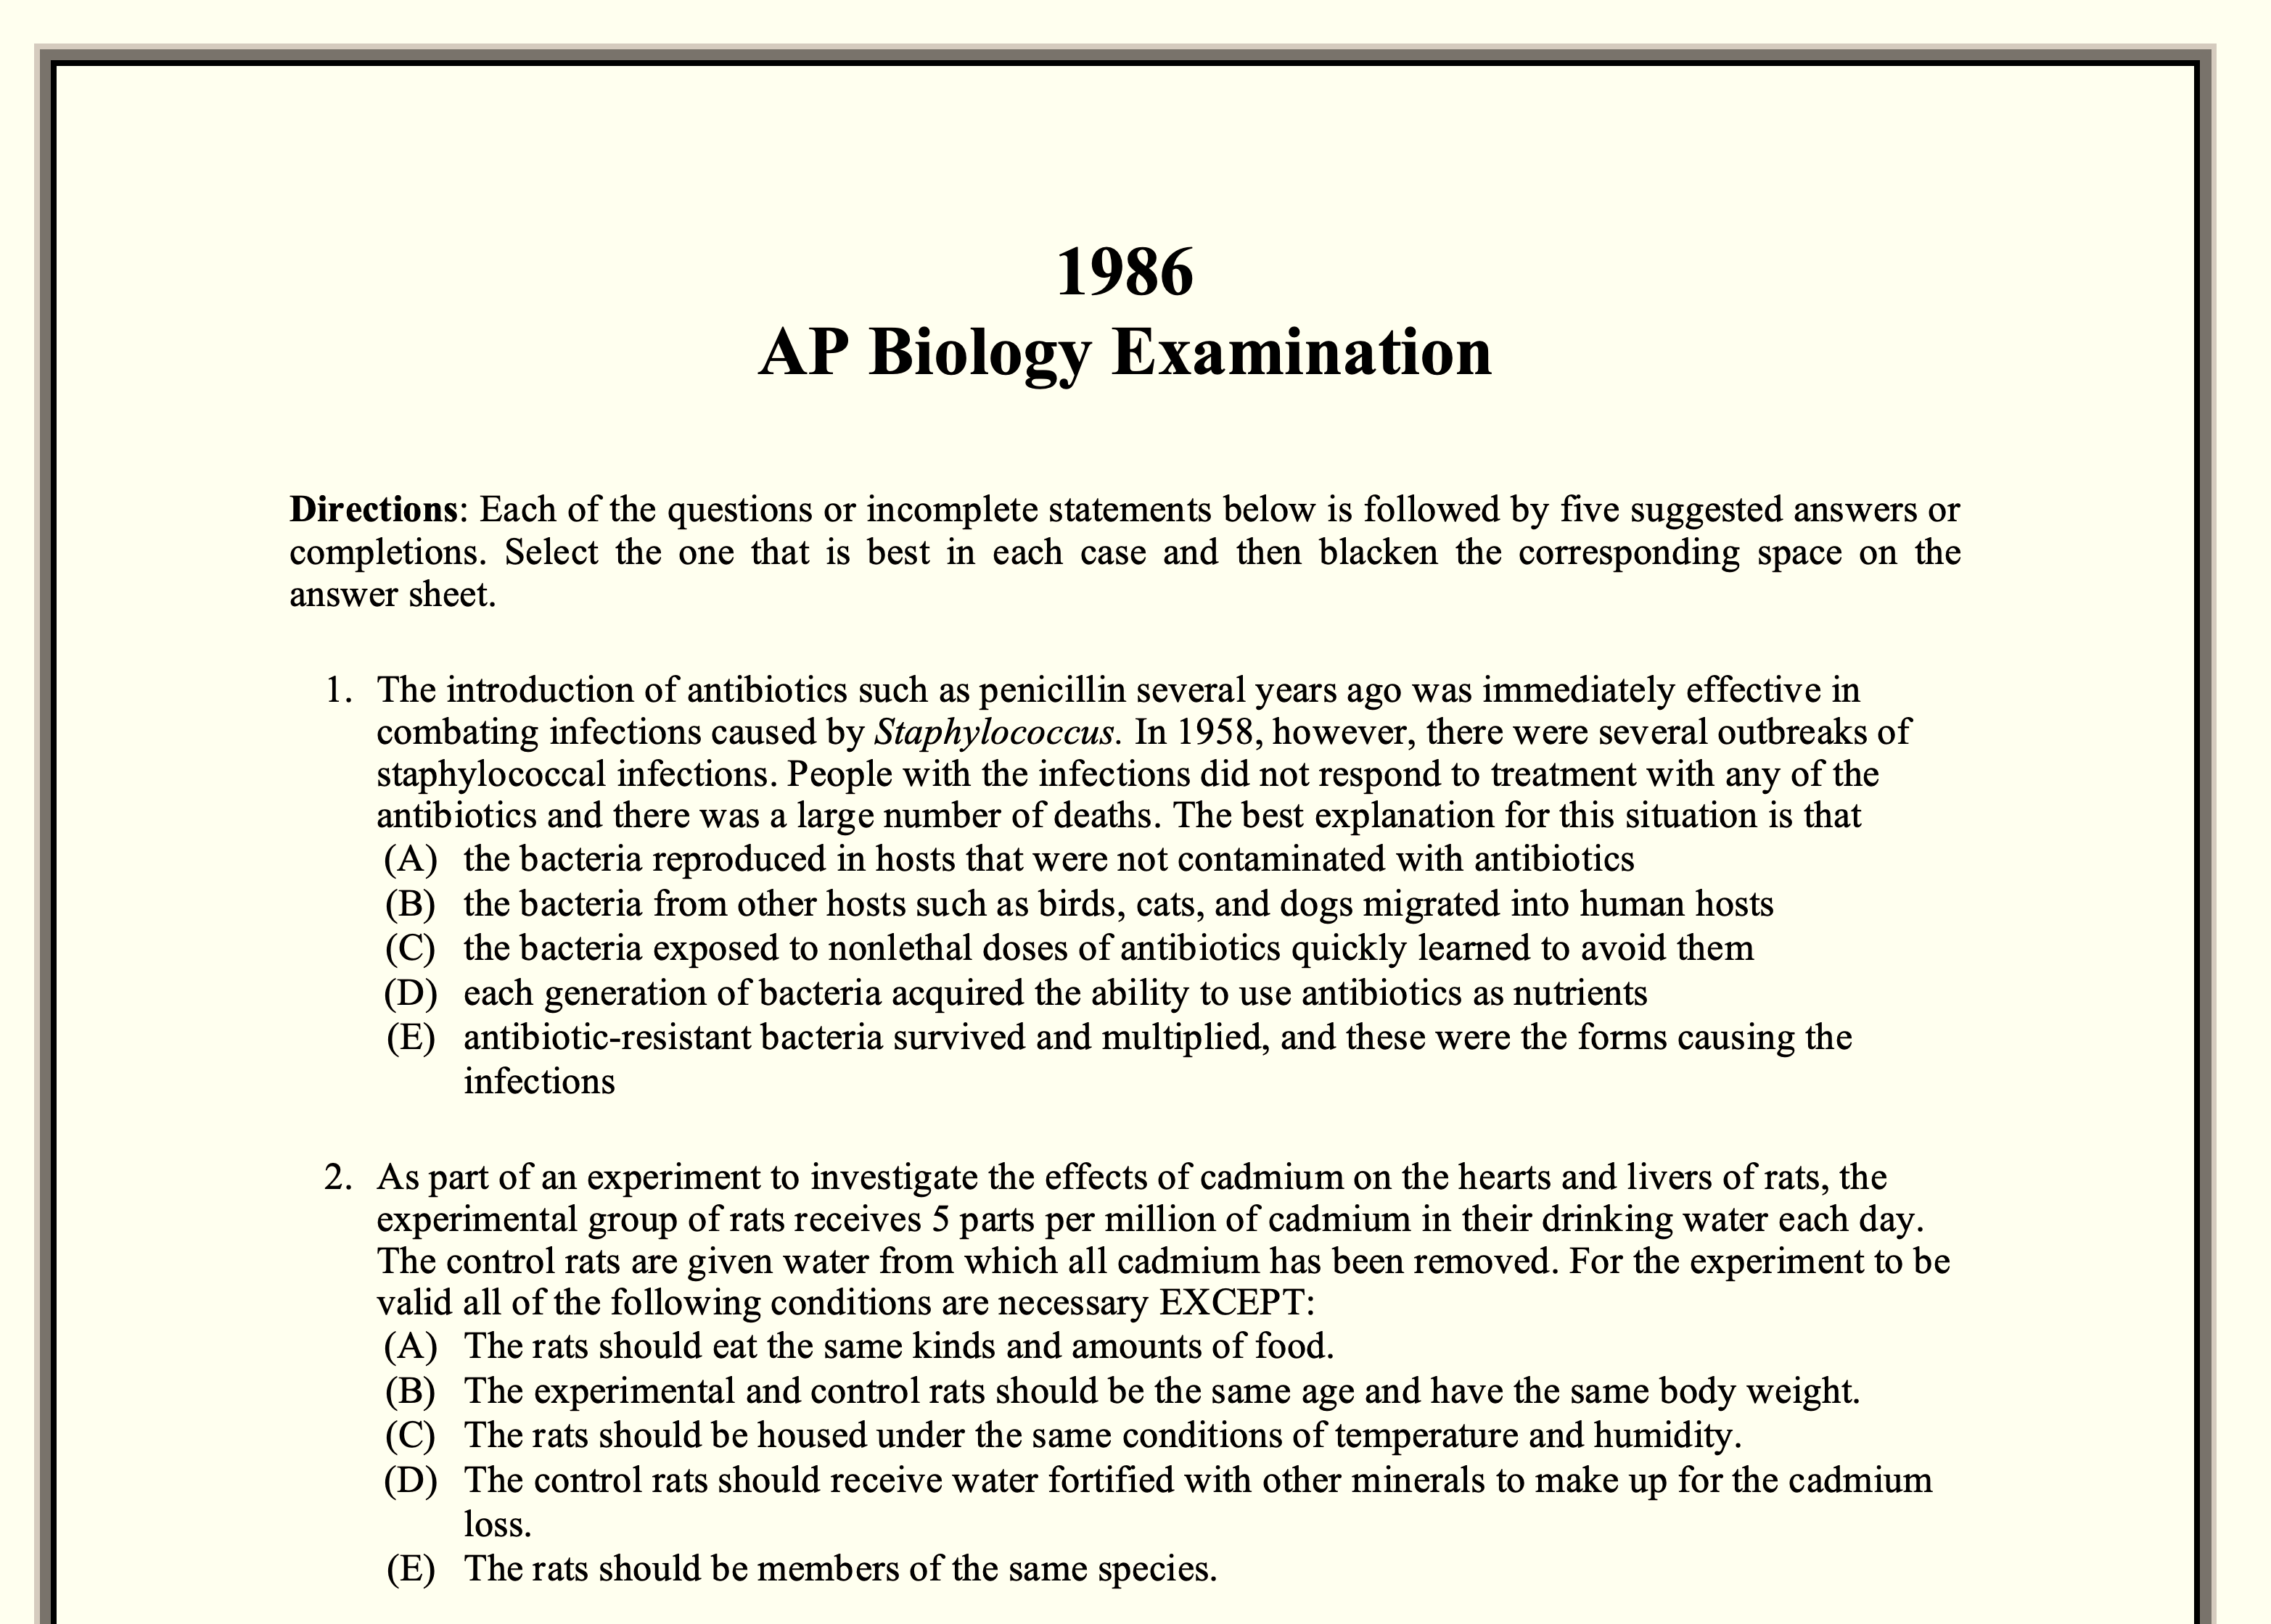
My (Limited) Background in Biology
Last formal biology course was long before you were born
Research is in security and privacy

Slide 18
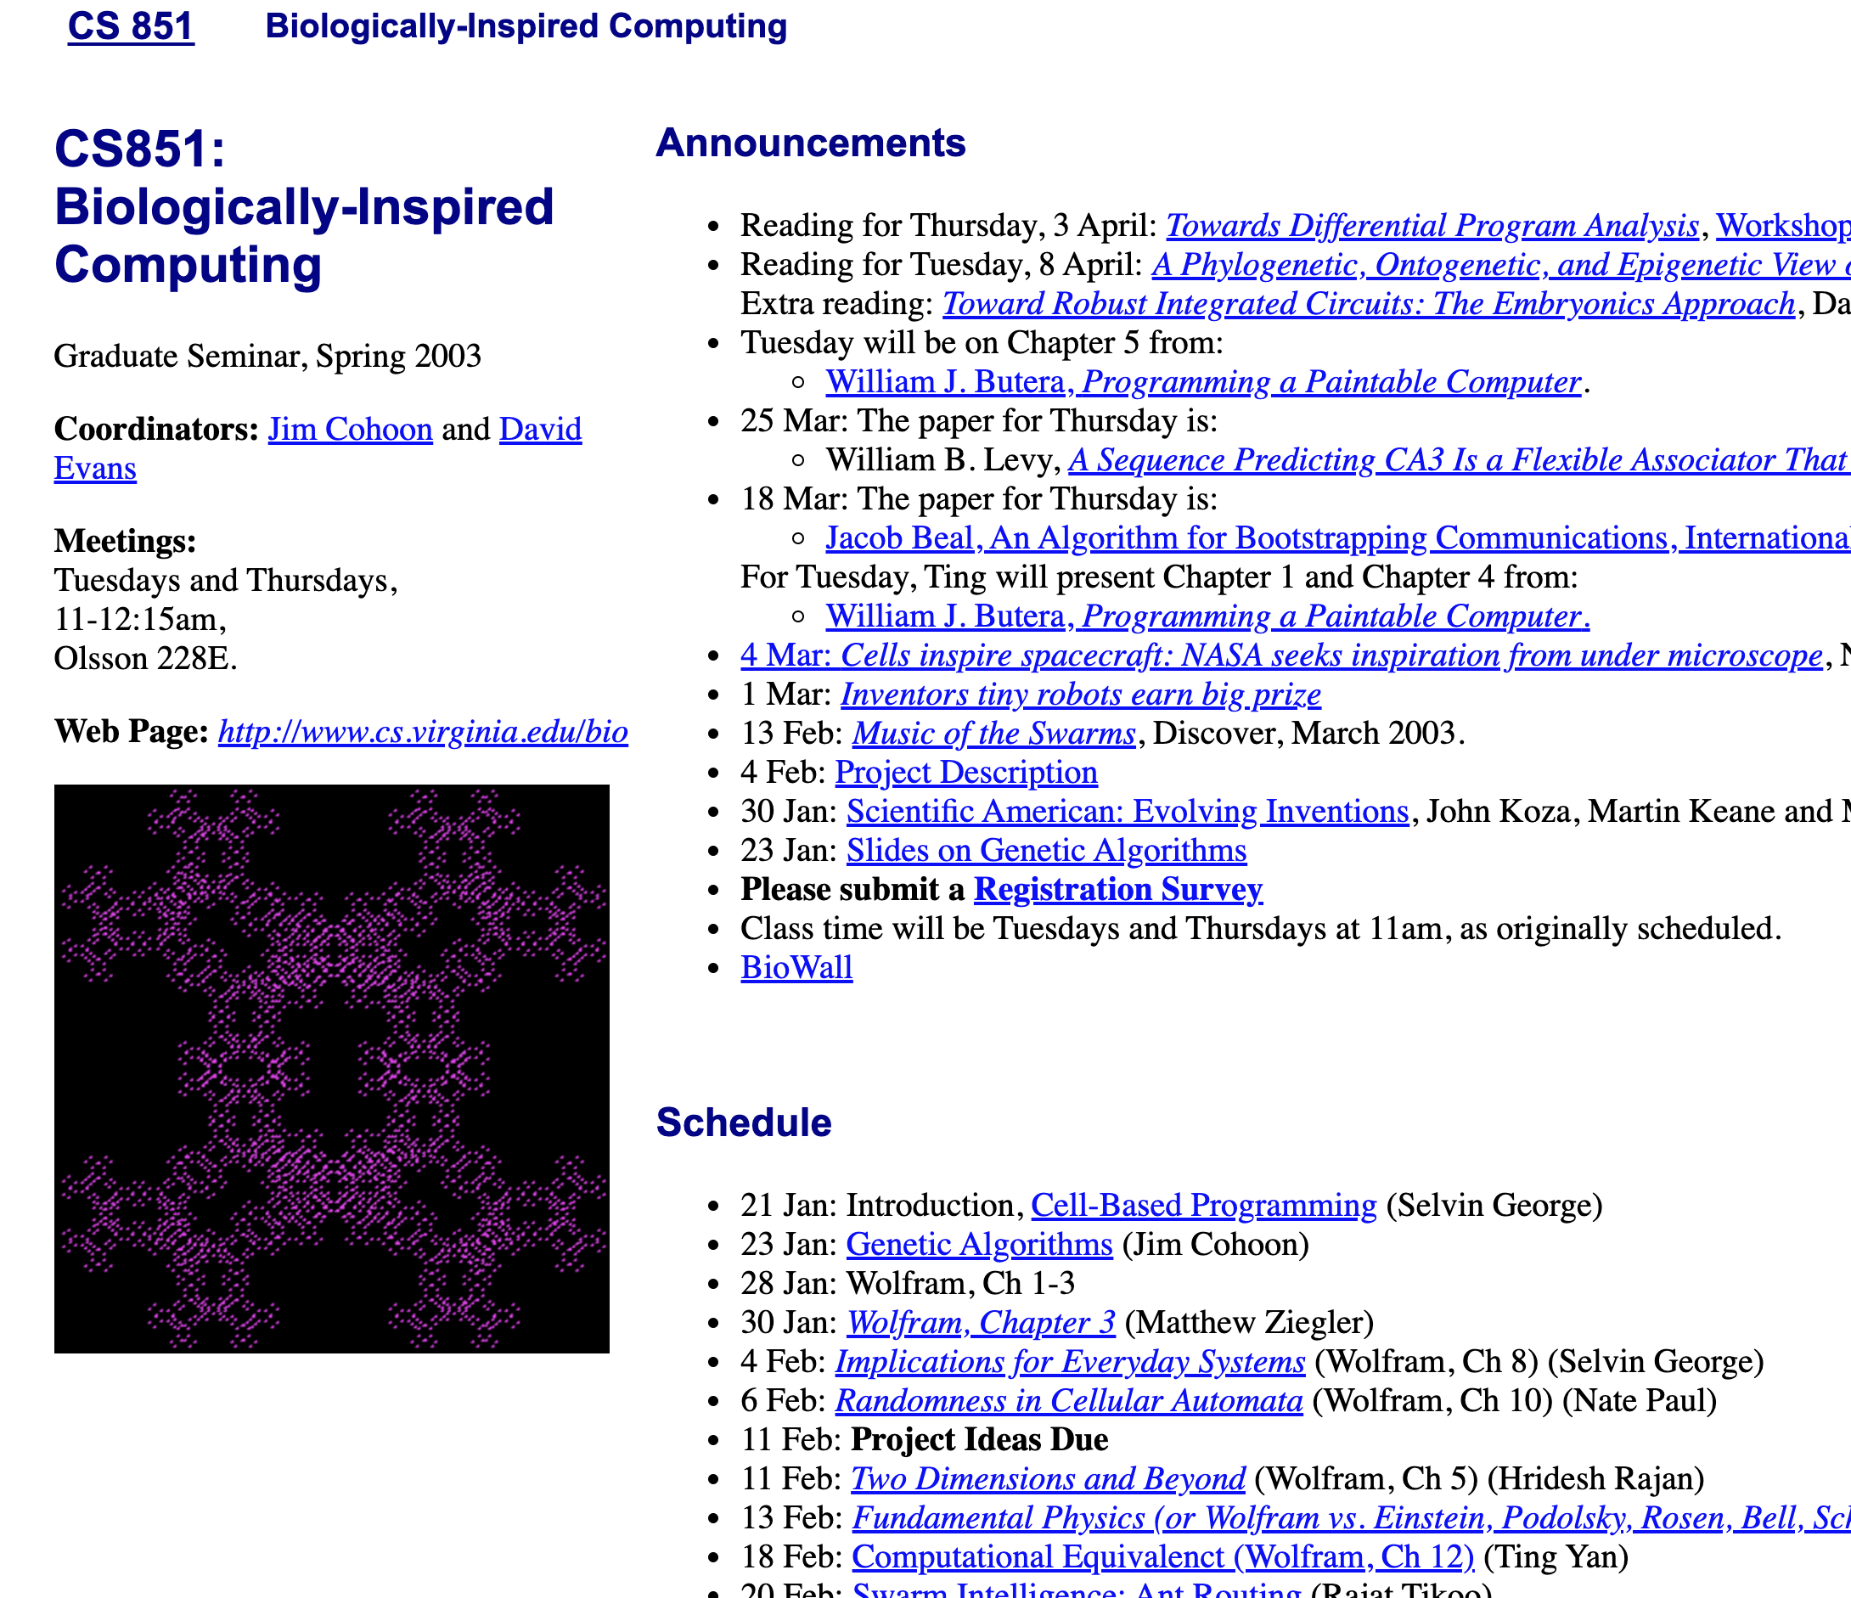
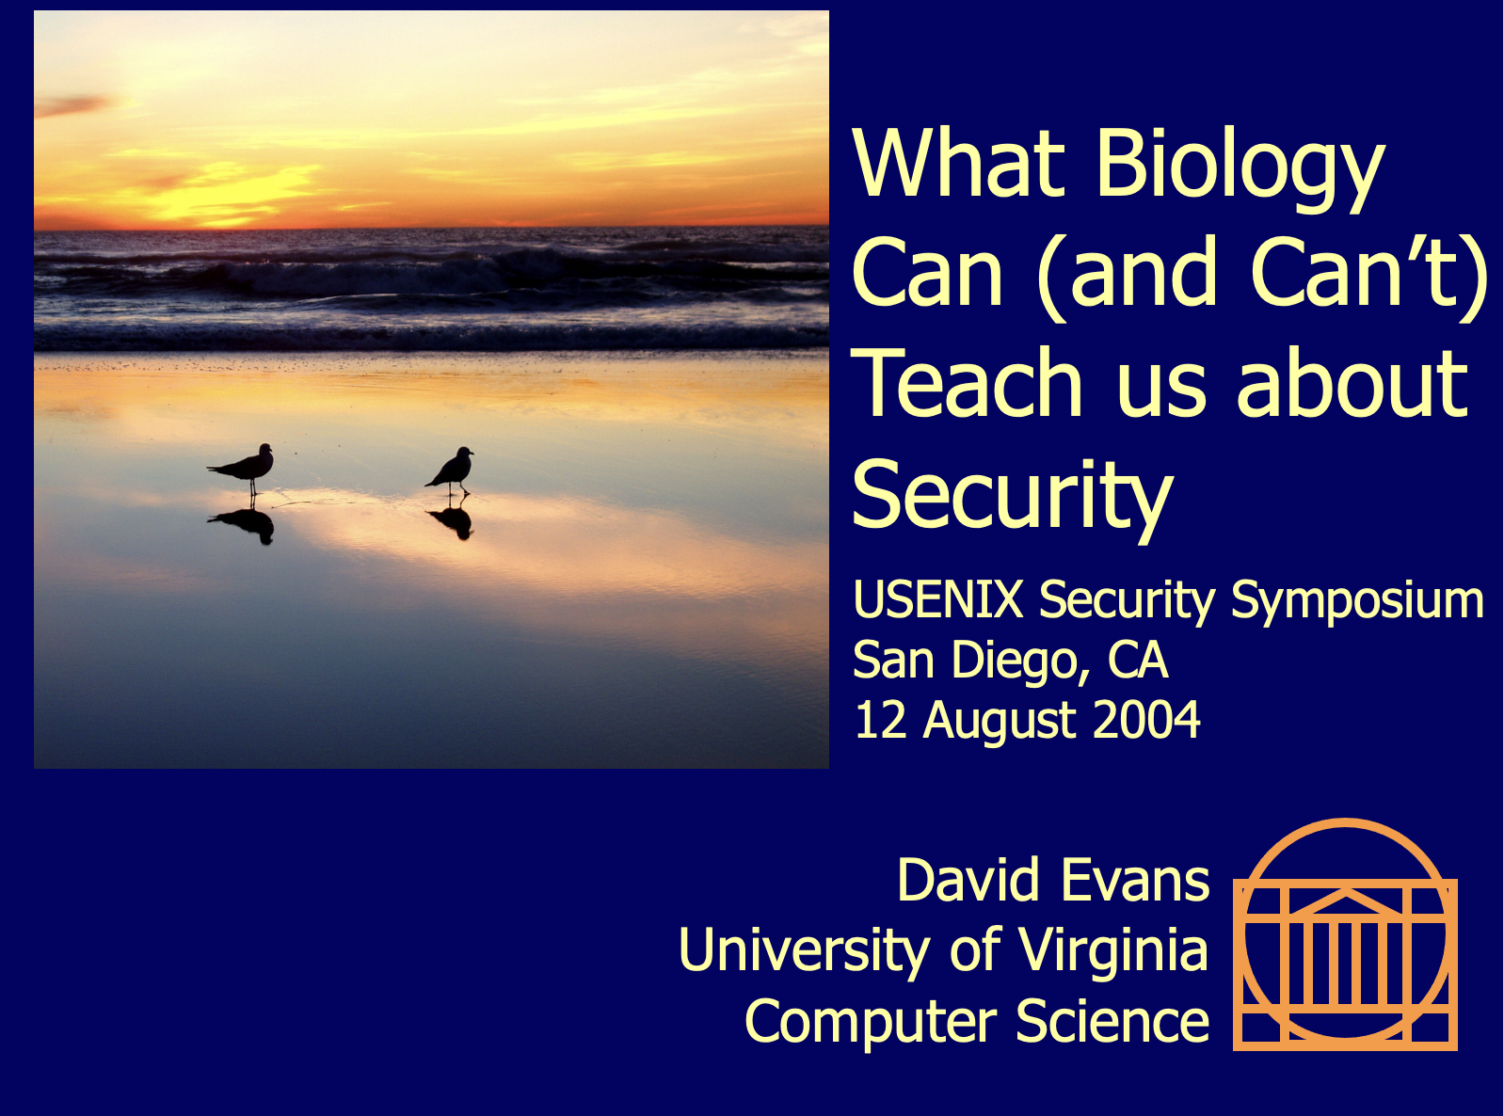
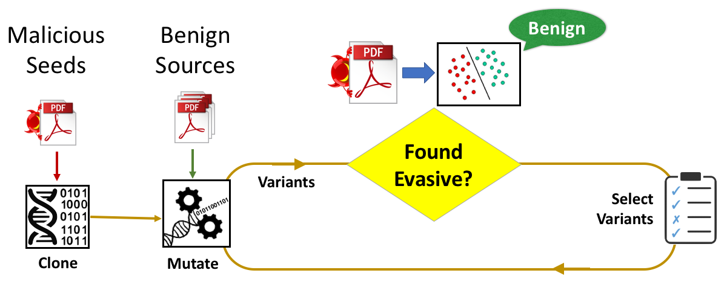
Long Interest in “Biologically-Inspired” Computing

Slide 19
My Goals for the Course
Learn a lot of new and interesting things!
Enable CS students with little biology background to apply computing to biological problems
(and realize we need to learn a lot more biology)
Fun, engaging experience for all
Upper-level electives should not be stressful
But, should have high expectations that students are interested in topic and self-motivated to learn and want to solve challenging problems

Slide 20
What I Expect of You
Course Pledge (please read it!)
Biology/chemistry experts
Please correct me when I say something wrong!
(and help answer questions I can’t)
Computer scientists with no biology background
Interrupt with questions if anything is unclear
Everyone: curious, open-minded, contribute to community

Slide 21
Balancing Humility and Arrogance
Outsiders entering new fields should:
Assume problems haven’t been solved because they are actually hard
Respect that people working in field have a lifetime of valuable and hard-won knowledge and experience
Accept that some things won’t be easily understood (and decide when it is worth putting in the effort needed to understand them)
Not be afraid to ask “dumb questions”
Read literature by mapping field’s jargon back to your own
Not accept that the way people in the field assume things are is correct/best way
Humility
Arrogance

Slide 22
Plan for the Course
Focused around Projects
Project 1: Genome Assembly (24 Jan - 6 Feb)
Project 2: Analyzing Genomes (7 Feb - 20 Feb)
Project 3: Engineering Vaccine (21 Feb – 4 March)
Project 4: Computing with Biology (14 – 27 March)
Final Project: Open Ended (about 5 weeks)
Classes and readings on related topics, and other ideas of interest

Slide 23
Questions on Course Plan

Slide 24
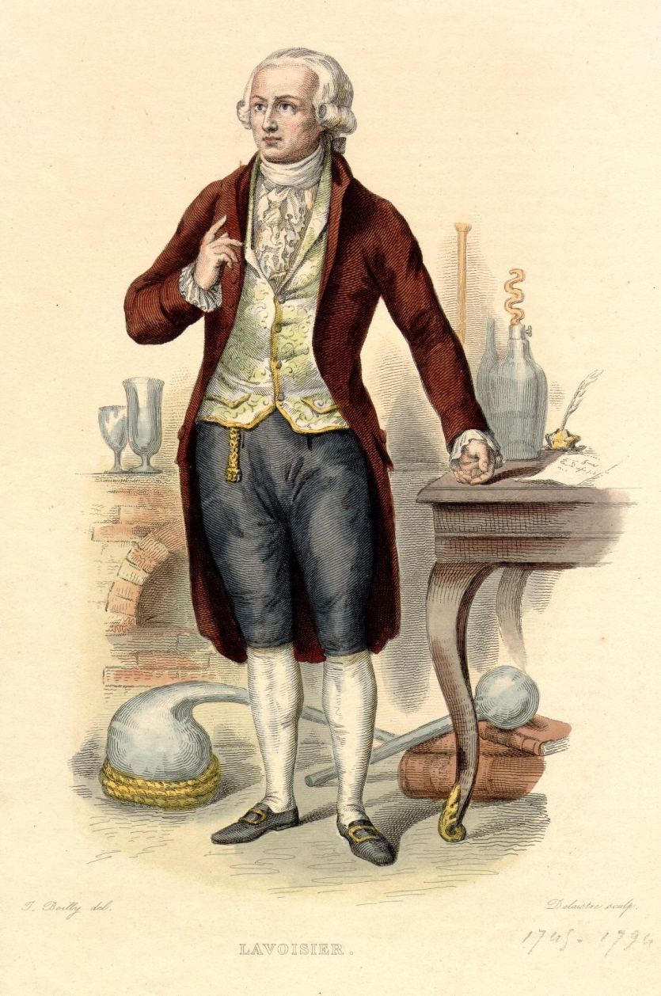
Life Science until 1900s
Life is about Magic
Life is about Chemistry
1735
Linnaeus
(classification by
properties)
1780
Lavoisier
1673
van Leeuwenhoek
(microbiology)
Antoine Lavoisier
1943-1794 (Paris)

Slide 25
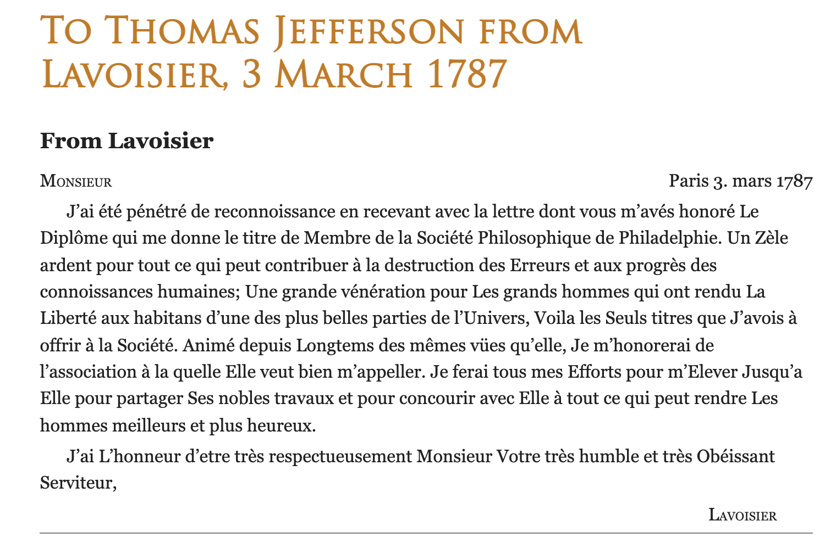
https://founders.archives.gov/documents/Jefferson/01-11-02-0208

Slide 26
Un Zèle ardent pour tout ce qui peut contribuer à la destruction des Erreurs et aux progrès des connoissances humaines.
An ardent Zeal for all that can contribute to the destruction of Errors and to the progress of human knowledge.
https://founders.archives.gov/documents/Jefferson/01-11-02-0208

Slide 27
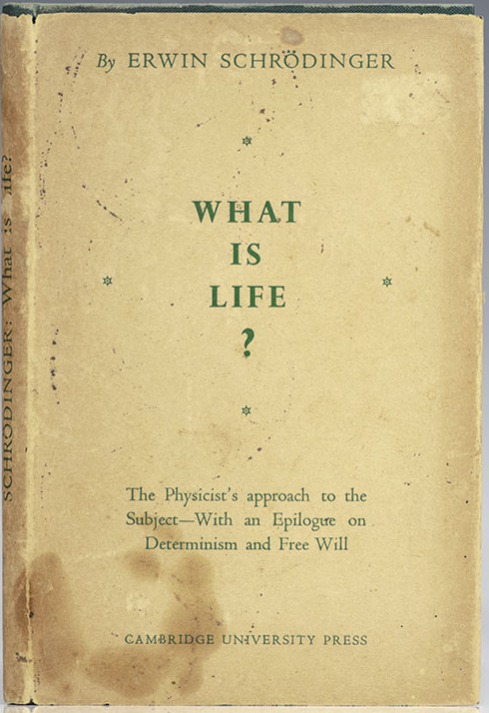
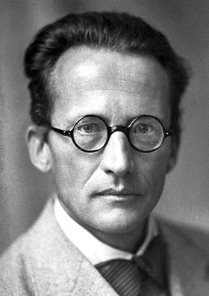
Erwin Schrödinger (1887-1961)
Nobel Prize in Physics, 1933
Public lectures in Dublin, 1943 (book in 1944)

Slide 28
“It is these chromosomes, or probably only an axial skeleton fibre of what we actually see under the microscope as the chromosome, that contain in some kind of code-script the entire pattern of the individual’s future development and of its functioning in the mature state….However little we understand the devices we cannot think that it must be in some way very relevant to the functioning of the organism, that every single cell … should be in possession of a complete (double) copy of the code-script.”
Public lectures in Dublin, 1943 (book in 1944)
Notes:
Note: Hermann Joseph Muller had this all by 1922 (but Schrodinger typically gets “credit”)

Slide 29
Life Science
Life is about Magic
Life is about Chemistry
Life is about Information
1735
Linnaeus
(classification by
properties)
1780
Lavoisier
1922
Muller
1943
Schrödinger
1673
van Leeuwenhoek
(microbiology)
Antoine Lavoisier
1943-1794 (Paris)

Slide 30
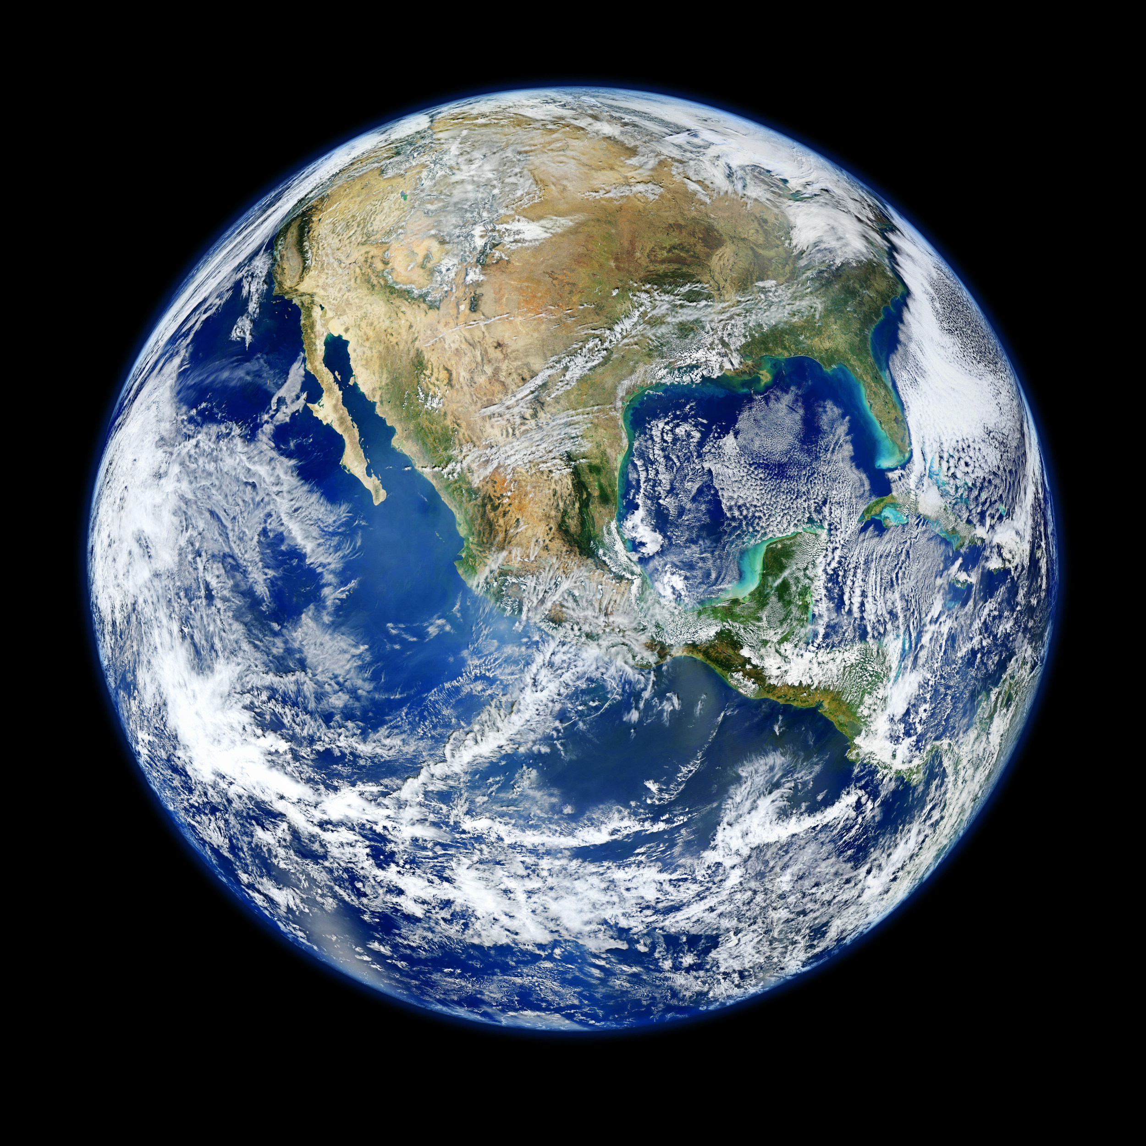
Challenges in Defining “Life”

Slide 31
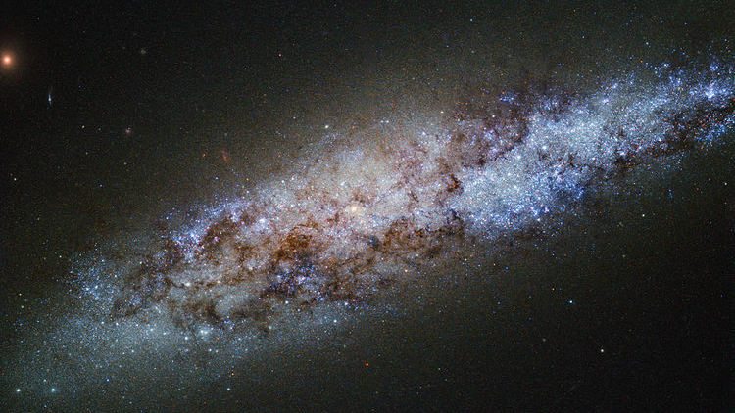
Challenges in Defining “Life”
Notes:
https://commons.wikimedia.org/wiki/File:The_scale_of_the_Universe.jpg
ESA/Hubble & NASA
Acknowledgement: D. Calzetti (University of Massachusetts) and the LEGUS Team

Slide 32

NASA’s Definition
“Life is a self-sustaining chemical system capable of Darwinian evolution”
https://astrobiology.nasa.gov/research/life-detection/about/

Slide 33

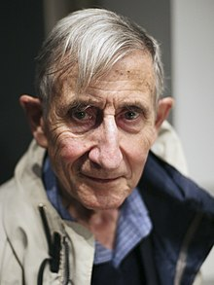
Freeman Dyson (1923-2020)
Based on Page-Barbour Lectures
“Life in the Universe”
at UVA (2004)

Slide 34
Challenges in Defining “Life”

Slide 35
All Known “Life” on Earth
Carbon-based
Why carbon?

Slide 36
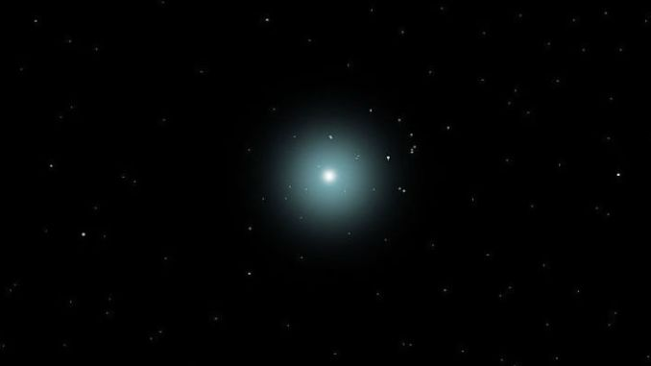
Essentially all Carbon in you (and in the universe) was produced by dying stars!

Slide 39
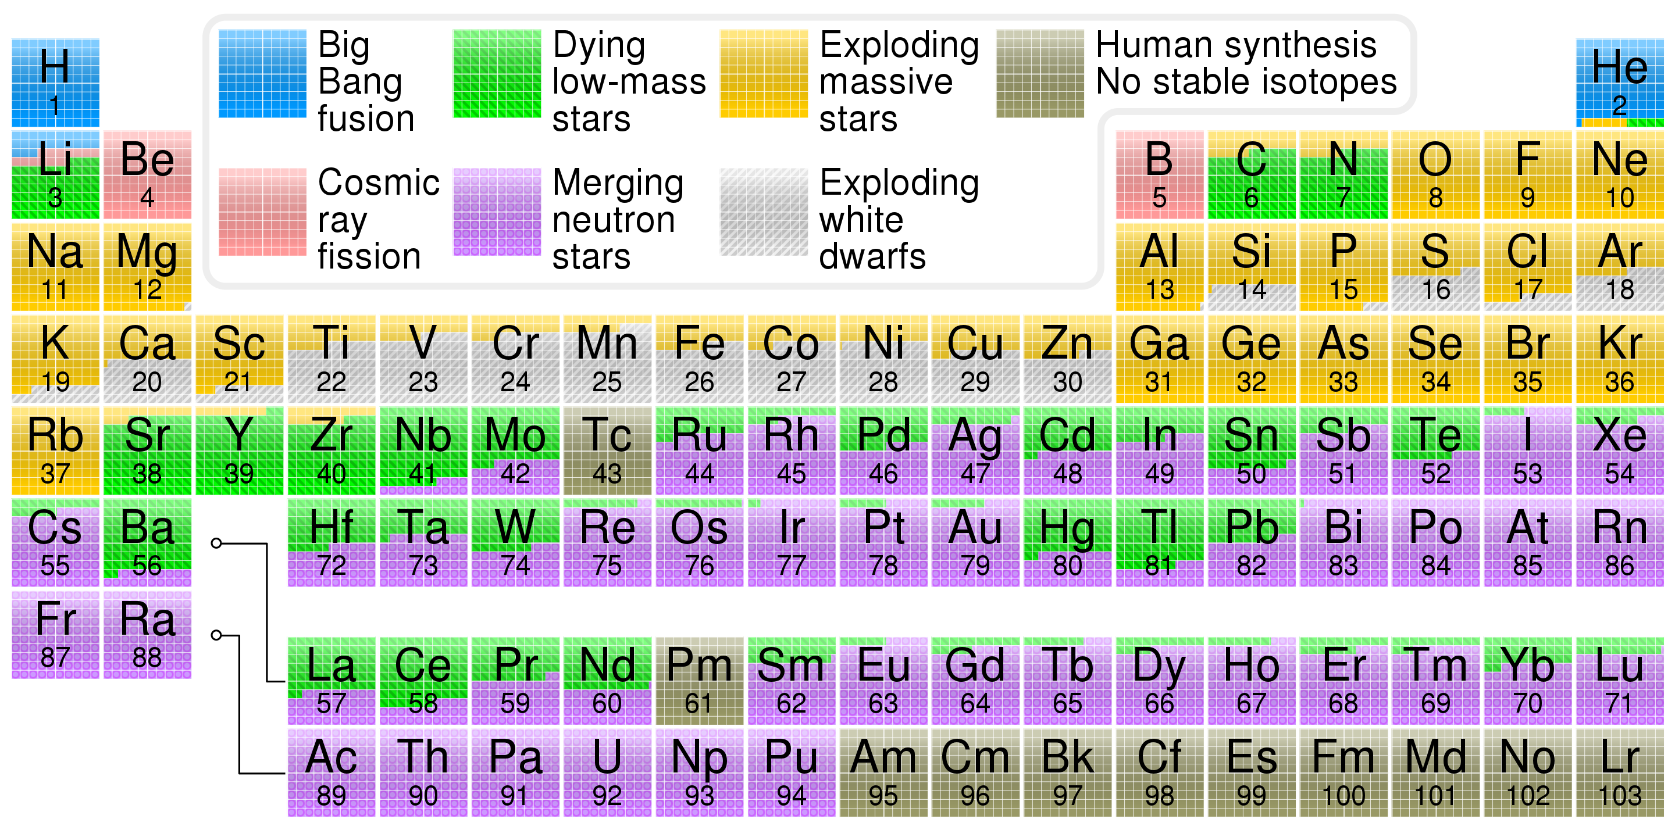
0.74
0.24
https://en.wikipedia.org/wiki/Abundance_of_the_chemical_elements#/media/File:Nucleosynthesis_periodic_table.svg
Source: Cmglee

Slide 40
0.74
0.24
4.6
1.0
10.4
1.09
1.34
0.65
Top 8 elements are 0.998 of mass of galaxy
Purple numbers are parts per thousand (by mass)
https://en.wikipedia.org/wiki/Abundance_of_the_chemical_elements#/media/File:Nucleosynthesis_periodic_table.svg
Source: Cmglee

Slide 41
All Known “Life” on Earth
Carbon-based
Relatively abundant
4th most abundant, 0.5% of total
Why carbon?

Slide 42
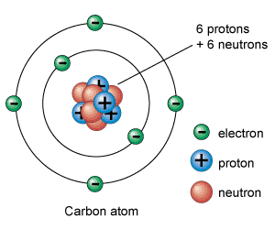
Usefulness of Carbon
4 free electrons:
outer ring can hold 8 electrons
can form covalent bonds (sharing electrons) with other atoms
Image source: https://www.universetoday.com/56469/atom-diagram/

Slide 43
Carbon Bonds
-
-
O
C
-
-
O
-
-
-
-
-
-
-
-
-
-
-
-

Slide 44
Carbon Bonds
-
-
O
C
-
-
O
-
-
-
-
-
-
-
-
-
-
-
-
Carbon Dioxide (CO₂)
Each oxygen: 6 electrons + sharing 2 with C (“double bond”) = 8 electrons
Carbon: 4 electrons + sharing 2 with O + sharing 2 with O = 8 electrons

Slide 45
Chains of Carbon
H
H
-
-
-
-
-
H
C
C
O
-
-
-
-
-
-
-
-
H
-
-
-
-
-
-
-
H
H
C₂H₅OH (Ethanol)
Notes:
This is ethanol (drinking alcohol)

Slide 46
All Known “Life” on Earth
Carbon-based
Relatively abundant
Good at bonding
Runs on the same platform

Slide 47
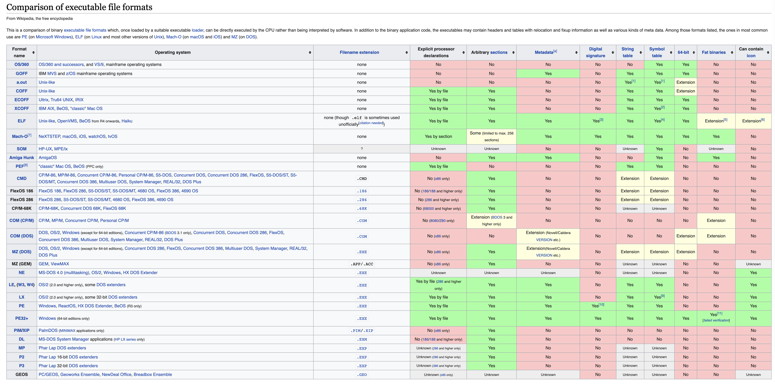
Life on Earth Executable Format
Single executable format, nearly compatible across all life on earth!
Executable File Formats for Computers
100s of different, incompatible formats

Slide 48
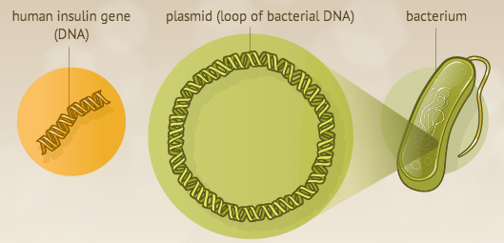
Life on Earth Executable Format
Single executable format, nearly compatible across all life on earth!
Human Insulin Program
(51 amino acids “instructions”)
E. Coli Bacterium
Makes Human Insulin: C₂₅₇H₃₈₃N₆₅O₇₇S₆
Image source: https://www.nlm.nih.gov/exhibition/fromdnatobeer/exhibition-interactive/recombinant-DNA/recombinant-dna-technology-alternative.html

Slide 49
Life on Earth Instruction Set
Nearly universal to all life on earth (some species found with minor differences)
Amino Acid | DNA Codons | Encodings
START | ATG | 1
STOP | TAA, TGA, TAG | 3
A | GCn | 4
B | AAT, AAC; GAT, GAC | 4
C | TGT, TGC | 2
D | GAT, GAC | 2
E | GAA, GAG | 2
F | TTT, TTC | 2
G | GGn | 4
H | CAT, CAC | 2
I | ATT, ATC, ATA | 3
K | AAA, AAG | 2
Amino Acid | DNA Codons | Encodings
L | CTn; TTA, TTG | 6
M | ATG | 1
N | AAT, AAC | 2
P | CCn | 4
Q | CAA, CAG | 2
R | CGn; AGA, AGG | 6
S | TCn; AGT, AGC | 6
T | ACn | 4
V | GTn | 4
W | TGG | 1
Y | TAT, TAC | 2
Z | CAA, CAG; GAA, GAG | 4
22 instructions: START, STOP, 20 (+2) Amino Acids

Slide 50
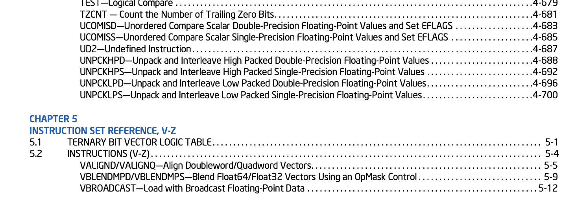
My Laptop’s Instruction Set
1000s of x86 instructions (but that’s just the main CPU!)

Slide 51
All Known “Life” on Earth
Carbon-based
Relatively abundant
Good at bonding
Runs on the same platform
Information stored in nucleotide sequences
Encoded the same way
Same mechanism for mapping nucleotides to proteins

Slide 52
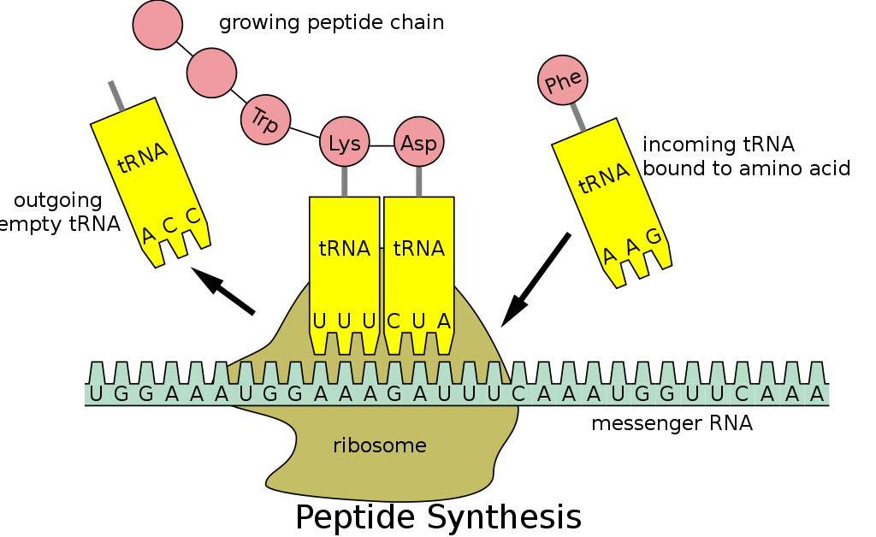
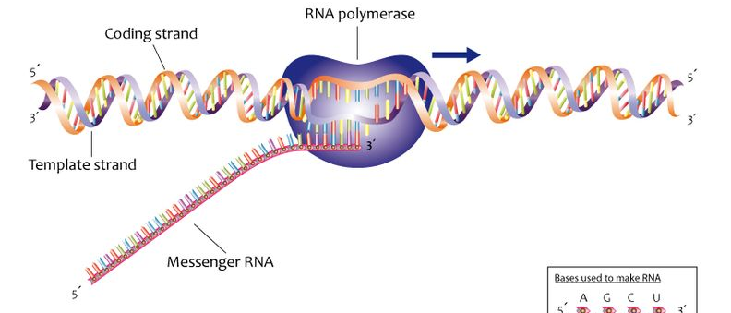
Interpreting Earth-Life Programs
(aka, “The Central Dogma of Biology”)
“transcribe”
“translate”
DNA
RNA Polymerase
RNA
Proteins
Ribosome
Reverse Transcriptase
Image: https://commons.wikimedia.org/wiki/File:Process_of_transcription_(13080846733).jpg
Image: https://en.wikipedia.org/wiki/Transfer_RNA#/media/File:Peptide_syn.svg
Notes:
Retroviruses (e.g., HIV) can do this backwards!

Slide 53
All Known “Life” on Earth
Carbon-based
Relatively abundant
Good at bonding
Runs on the same platform
Information stored in nucleotide sequences
Encoded the same way
Same mechanism for mapping nucleotides to proteins
Same physics determines function of protein
Same process for information-replication
Same process for evolutionary improvement

Slide 54
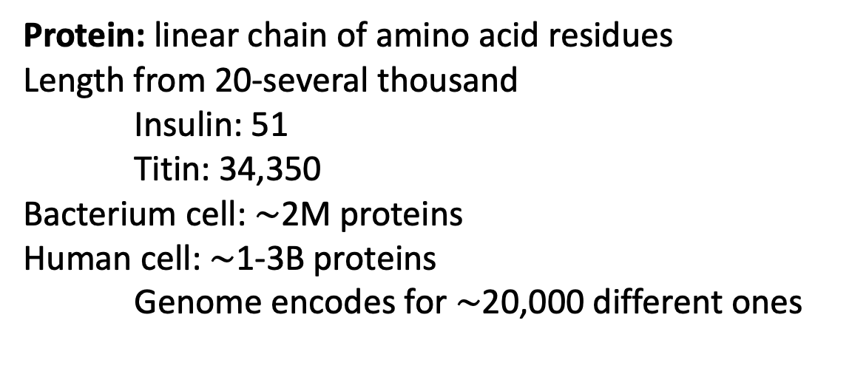
Protein Physics and Function
“translate”
Protein: linear chain of amino acid residues
Length from 20-several thousand
Insulin: 51
Titin: 34,350
Bacterium cell: $\sim$2M proteins
Human cell: $\sim$1-3B proteins
Genome encodes for $\sim$20,000 different ones
Proteins
Ribosome
Shape of a protein determined by physics
atoms have charges that attract/repel each other
Function of a protein determined by its shape
53
Image: https://en.wikipedia.org/wiki/Transfer_RNA#/media/File:Peptide_syn.svg

Slide 55
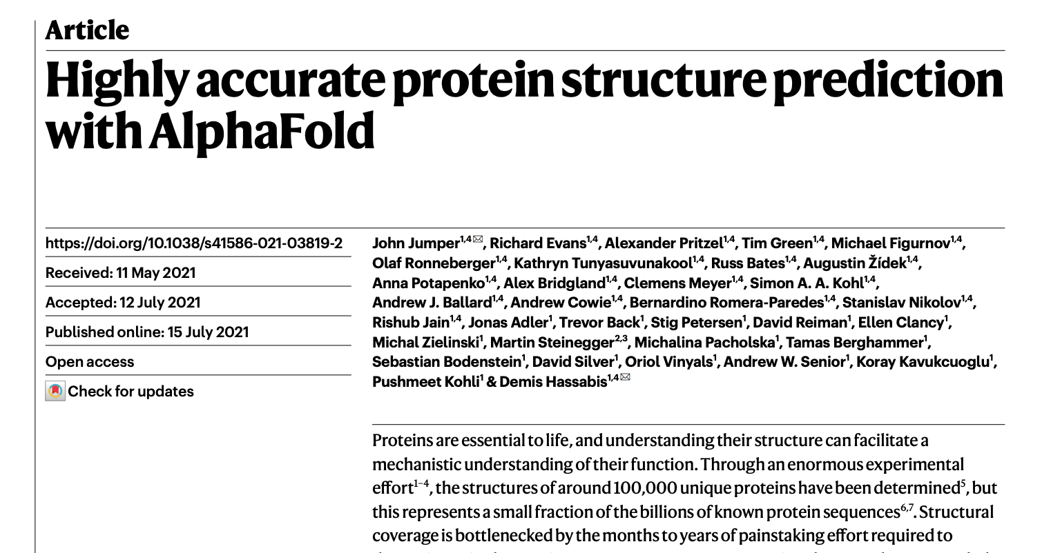
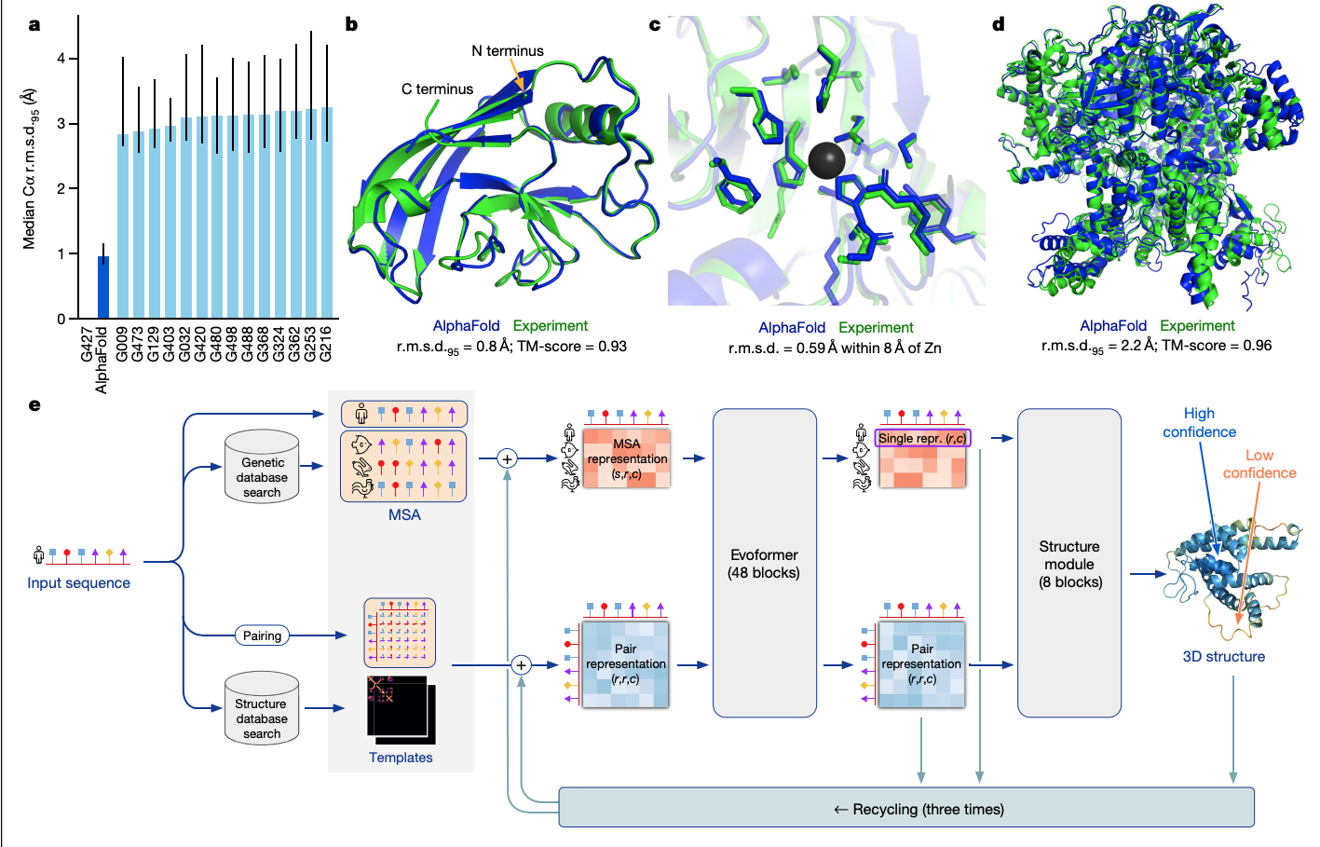
Predicting Protein Shape

Slide 56
All Known “Life” on Earth
Carbon-based
Relatively abundant
Good at bonding
Runs on the same platform
Information stored in nucleotide sequences
Encoded the same way
Same mechanism for mapping nucleotides to proteins
Same physics determines function of protein
Same process for information-replication
Same process for evolutionary improvement

Slide 57
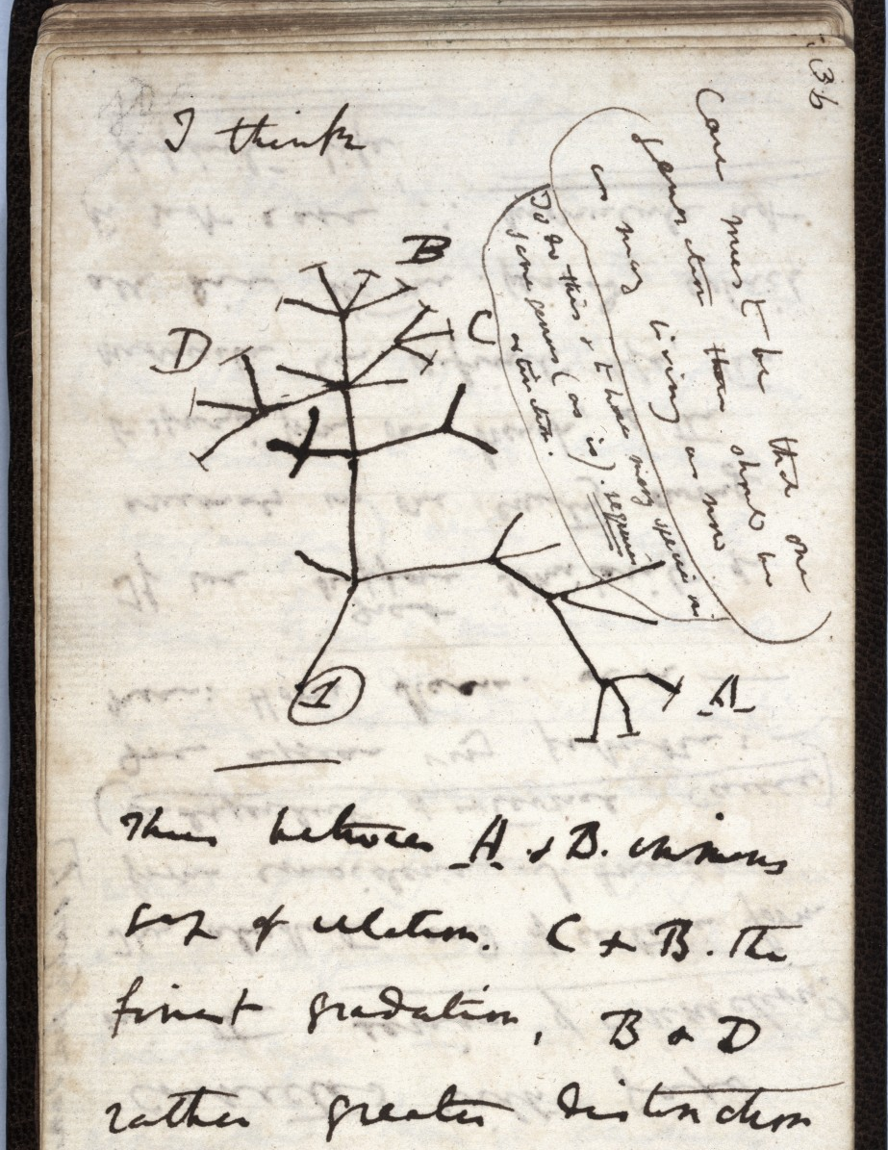
Evolution by Natural Selection
Charles Darwin’s Notebook, 1837
http://darwin-online.org.uk/content/frameset?itemID=CUL-DAR121.-&pageseq=38

Slide 58
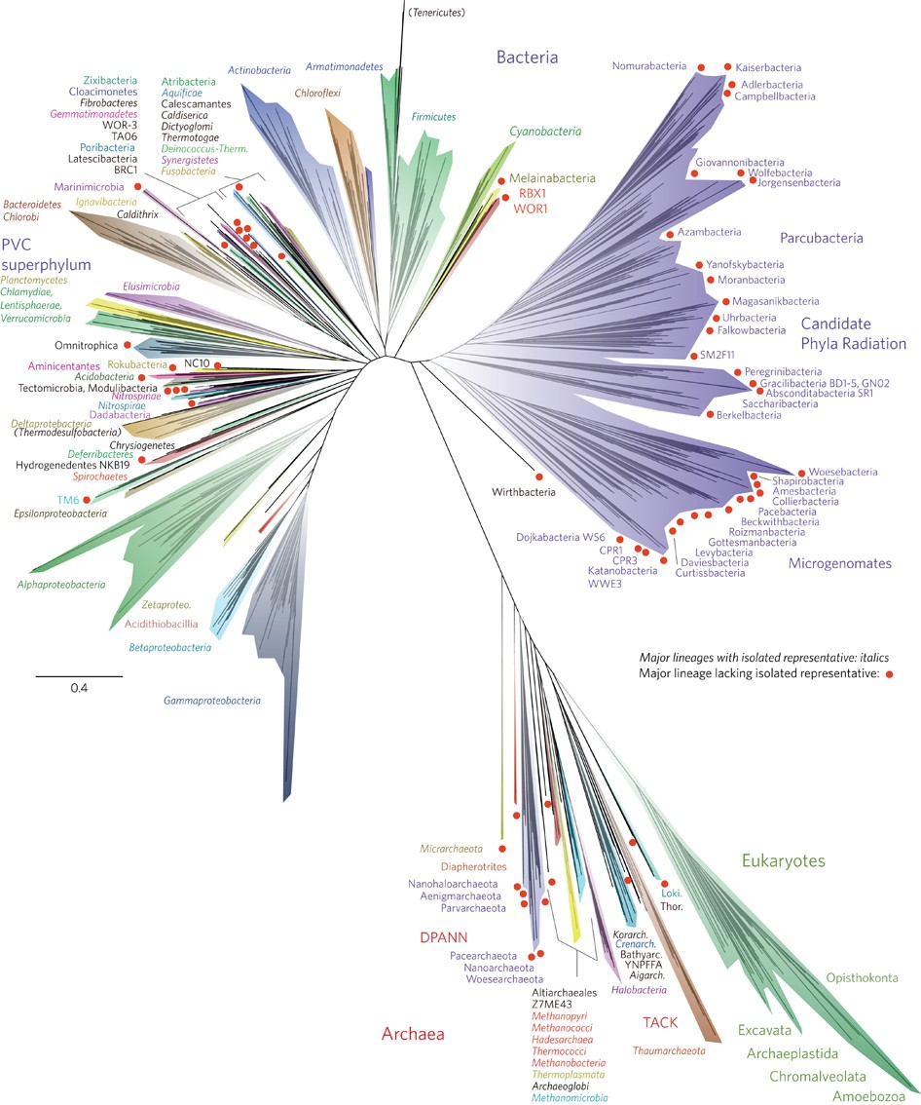
Slide idea based on Phillip Compeau’s slide
Laura Hug et al., A new view of the tree of life, 2016
https://www.nature.com/articles/nmicrobiol201648
Notes:
Archea (ar-Kee a)

Slide 59
3 Billion years ago
2 Billion years ago
1.3 Billion years ago
Opisthokonta (fungi, animals)
Laura Hug et al., A new view of the tree of life, 2016
https://www.nature.com/articles/nmicrobiol201648
Notes:
Archea (ar-Kee a)

Slide 60
Why is Life Digital?

Slide 61
Charge
Everyone in the class should:
- Complete Registration Survey
- Join Slack
- Join Github (you’ll get invitation from me after registration survey)
Readings for Week 1: on course site
Next week (and Project 1): Genome Assembly

